Slide 1
Passion project: Hurricane Sandy
Mohamed Elarqem

Slide 2
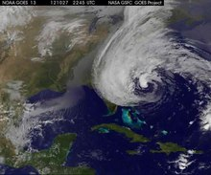
What is Hurricane Sandy
Hurricane Sandy is a massive, deadliest, destructive, and stronger storm that is accompanied by a significant wind and flooding.
Hurricane Sandy is also known as Superstorm Sandy.
Hurricane Sandy started as a tropical wave that later developed into a tropical depression and quickly transitions to a tropical cyclone.
Within less than 48 hours, the tropical cyclone transitioned to be a Category 1 hurricane with estimated winds of about 74 mph (Neppalli et al., 2017).
Notes:
Hurricane Sandy started as a tropical wave that later developed into a tropical depression and quickly transitions to a tropical cyclone. Within less than 48 hours, the tropical cyclone has transitioned to be a Category 1 hurricane with estimated winds of about 74 mph (Neppalli et al., 2017).

Slide 3
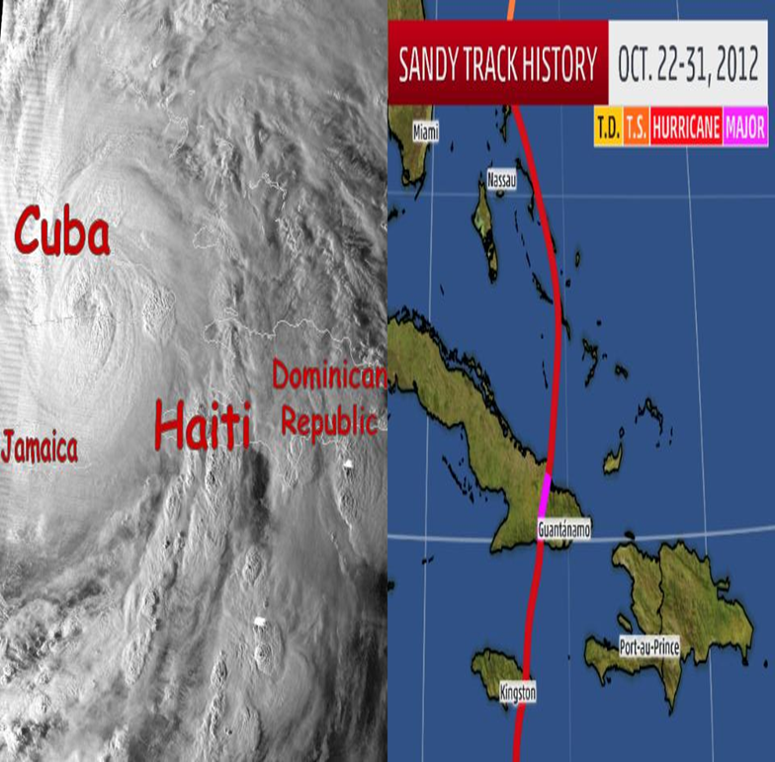
Hurricane Sandy timelines (part a)
Hurricane Sandy started on October 22, 2012, in the Caribbean Sea.
After two days, the Hurricane made landing in Jamaica and was at about 80 mph, and was official considered a Category 1 Hurricane.
On October 25th, 2012, Hurricane Sandy travelled to Cuba, and at the time, it was about 105 mph winds which made it be categorized as Category 2.
The Hurricane travelled to both the Bahamas and Haiti, where it claimed 54 lives in Haiti and 2 people in the Bahamas.
Later the Hurricane transitioned to the Dominican Republic, where it claimed another 11 people (Mitsova et al., 2018).
From October 26th to 27th 2012, the Hurricane seems to lose its power where it had transitioned back from Category 1 to a tropical storm on 26th but later resumed to be a category 1 by 27th.
Notes:
Hurricane Sandy started on October 22, 2012, in the Caribbean Sea.
After two days, the Hurricane made landing in Jamaica and was at about 80 mph, and was official considered a Category 1 Hurricane.
On October 25th, 2012, Hurricane Sandy travelled to Cuba, and at the time, it was about 105 mph winds which made it be categorized as Category 2. The Hurricane travelled to both the Bahamas and Haiti, where it claimed 54 lives in Haiti and 2 people in the Bahamas. Later the Hurricane transitioned to the Dominican Republic, where it claimed another 11 people (Mitsova et al., 2018).
From October 26th to 27th 2012, the Hurricane seems to lose its power where it had transitioned back from Category 1 to a tropical storm on 26th but later resumed to be a category 1 by 27th.

Slide 4
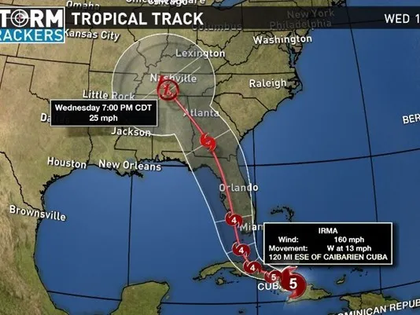
Hurricane Sandy timelines (part b)
On October 28th, 2017, Hurricane Sunday travelled to Georgia, South Carolina, and parts of North Carolina.
On its path, it was characterized to be destructive in nature.
On October 29th, 2012, Hurricane Sandy made a landing on the East Coast of America.
At the time, it has transitioned to a category 2 but a later weekend to be a tropical storm.
Nonetheless, the damages witnessed in these regions were massive.
For instance, the hurricane introduced high winds and drenching rains which was witnessed from Washington D.C to the rest of the northern regions.
Later the hurricane made a landing into Atlantic City with estimated wind speeds of about 90mph with a high tide, which resulted in a 14-foot wave surge that was evident across New York, especially in lower Manhattan.
At the same time, rains continued to hammer the city throughout the night, with about three tidal cycles witnessed.
On October 30th, 2012, Hurricane Sandy was identified to move far from New York and progress into other regions in the Northeast.
On October 31st, 2012, Hurricane Sandy identified to make for western Pennsylvania and made a disappearance and left behind heavy snow over the Appalachian Mountains.
Notes:
On October 28th, 2017, Hurricane Sunday travelled to Georgia, South Carolina, and parts of North Carolina. On its path, it was characterized to be destructive in nature.
On October 29th, 2012, Hurricane Sandy made a landing on the East Coast of America. At the time, it has transitioned to a category 2 but a later weekend to be a tropical storm. Nonetheless, the damages witnessed in these regions were massive. For instance, the hurricane introduced high winds and drenching rains which was witnessed from Washington D.C to the rest of the northern regions. Later the hurricane made a landing into Atlantic City with estimated wind speeds of about 90mph with a high tide, which resulted in a 14-foot wave surge that was evident across New York, especially in lower Manhattan. At the same time, rains continued to hammer the city throughout the night, with about three tidal cycles witnessed.
On October 30th, 2012, Hurricane Sandy was identified to move far from New York and progress into other regions in the Northeast.
On October 31st, 2012, Hurricane Sandy identified to make for western Pennsylvania and made a disappearance and left behind heavy snow over the Appalachian Mountains.

Slide 5
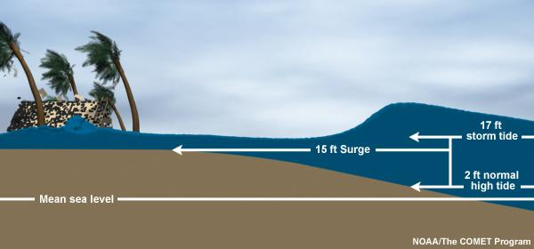
How was Hurricane Sandy caused?
A combination of numerous weather events was responsible for creating Hurricane Sandy.
Some researchers have claimed climate change also played a vital role in the development of Hurricane Sandy, which was attributed to the rise in global warming.
Nonetheless, there are three key weather factors that combined to form Hurricane Sandy.
First, there were huge storms that gashed with forces of about 90mph (Neppalli et al., 2017).
Second, there was a block of high pressure in the North-eastern Atlantic Ocean, which further made Hurricane Sandy very strong.
Third, the conditions presented in its formation were perfectly similar to that of the 1991 “Perfect Storm,” which happened when a nor’easter was fed by Arctic air that absorbed Hurricane Grace.
Notes:
A combination of numerous weather events was responsible for creating Hurricane Sandy. Some researchers have claimed climate change also played a vital role in the development of Hurricane Sandy, which was attributed to the rise in global warming. Nonetheless, there are three key weather factors that combined to form Hurricane Sandy. First, there were huge storms that gashed with forces of about 90mph (Neppalli et al., 2017). Second, there was a block of high pressure in the North-eastern Atlantic Ocean, which further made Hurricane Sandy very strong. Third, the conditions presented in its formation were perfectly similar to that of the 1991 “Perfect Storm,” which happened when a nor’easter was fed by Arctic air that absorbed Hurricane Grace.

Slide 6
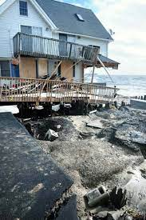
Hurricane Sandy landfall
Hurricane Sandy's initial landfall was in Jamaica as a Category I hurricane on October 24th, 2012, and later the following day transitioned to Cuba, where there were massive destructions witnessed then Haiti, Dominican Republic, and the Bahamas (Neppalli et al.,2017).
Sandy landed in the U.S on October 29th, 2012, near Atlantic City, later in New Jersey at the time. The winds were over 90 mph.
Notes:
Hurricane Sandy's initial landfall was in Jamaica as a Category I hurricane on October 24th, 2012, and later the following day transitioned to Cuba, where there were massive destructions witnessed then Haiti, Dominican Republic, and the Bahamas (Neppalli et al.,2017). Sandy landed in the U.S on October 29th, 2012, near Atlantic City, later in New Jersey at the time. The winds were over 90 mph.

Slide 7
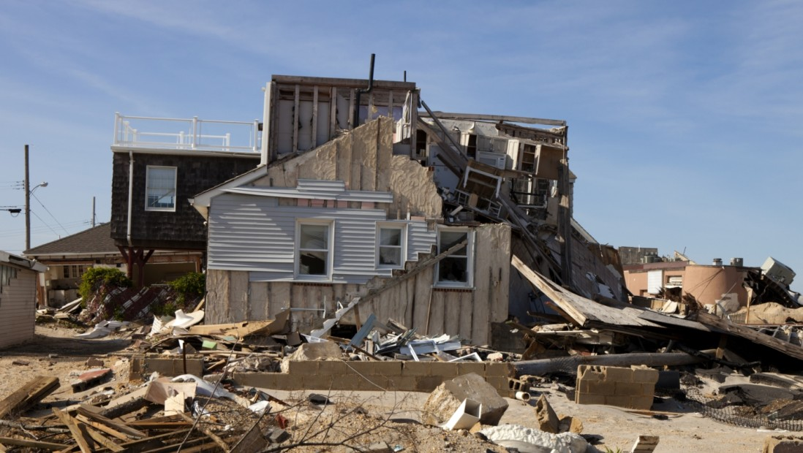
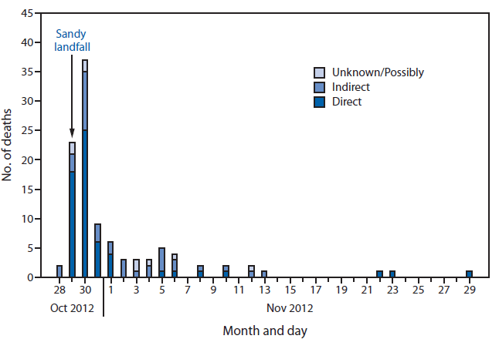
How was Hurricane Sandy detrimental? (part a)
In U.S history, Hurricane Sandy is identified as the fourth most expensive hurricane in American history.
An estimated 650,000 houses were damaged, which resulted in about $70.2 billion worth of damages caused in respective regions the hurricane fell.
According to the National Hurricane Centre, an estimated 147 persons either lost their lives from drowning in the storm surges and the flooding.
Notes:
In U.S history, Hurricane Sandy is identified as the fourth most expensive hurricane in American history. An estimated 650,000 houses were damaged, which resulted in about $70.2 billion worth of damages caused in respective regions the hurricane fell.
According to the National Hurricane Centre, an estimated 147 persons either lost their lives from drowning in the storm surges and the flooding. In the U.S alone, the lives lost were 72, while in Haiti, an estimated 54 deaths were reported (Lee, et al.,2020).

Slide 8
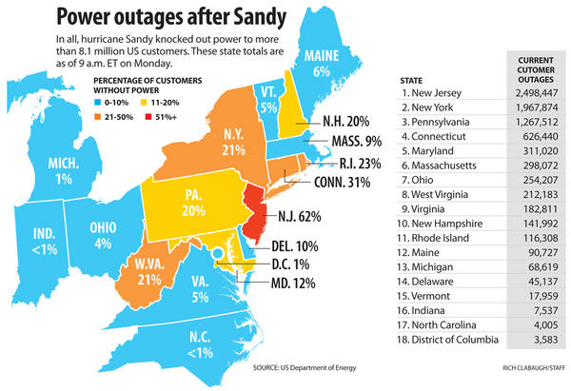
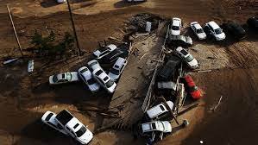
How was Hurricane Sandy detrimental? (part b)
In the U.S alone, the lives lost were 72, while in Haiti, an estimated 54 deaths were reported (Lee, et al.,2020).
As a result of the hurricane, about 8.5 million people experienced power outages.
They had to stay for weeks before they were reconnected, which resulted in the communities having to halt emergency services such as hospitals and fire fighting.
In addition, the Hurricane resulted in strong record-breaking surges, which resulted in flooding in both New Jersey and New York.
It also destroyed vehicles and other valuable items.
Notes:
As a result of the hurricane, about 8.5 million people lost their power and had to stay for weeks before they were reconnected, which resulted in the communities having to halt emergency services such as hospitals and fire fighting. In addition, the Hurricane resulted in strong record-breaking surges, which resulted in flooding in both New Jersey and New York cities.

Slide 9
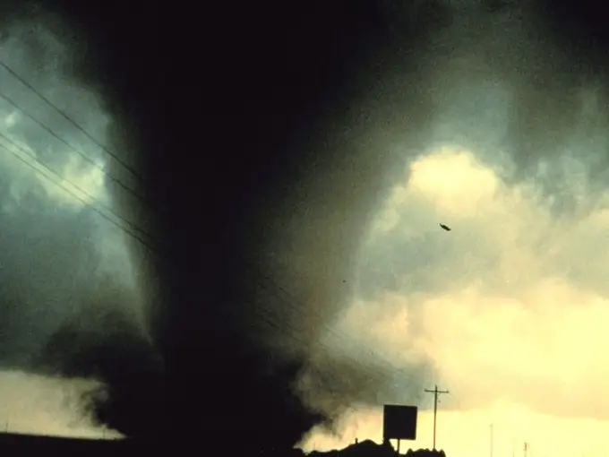
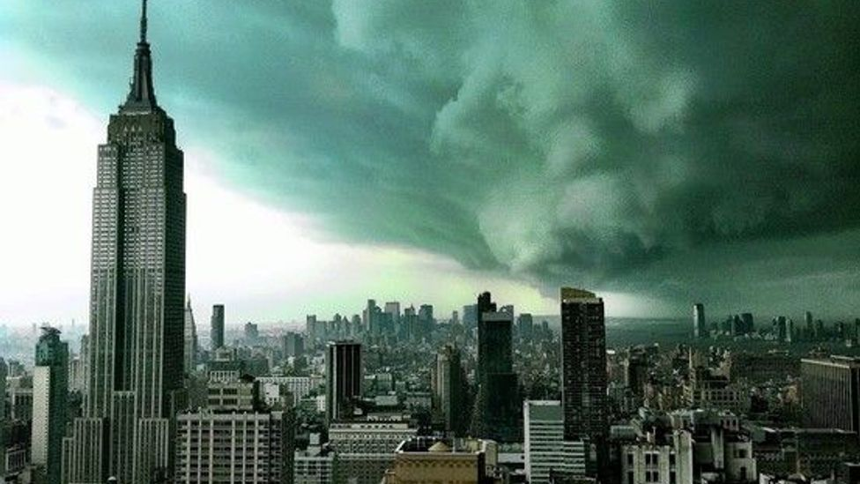
Fun facts about Hurricane Sandy (Part a)
A hurricane has the potential in one region to dump over 6 inches of rain in a region before it moves to the next region (Neppalli et al., 2017).
The heaviest of the rains in hurricanes occur at the centre of the eye of the hurricanes. This is witnessed with the ring of clouds that surround the eye of the hurricanes and the continuous thunder and lightning identified at the eye of the hurricane.
Hurricanes have the potential to generate tornadoes. This results in two natural disasters at the same time, which cause more destruction.
With every second of lightning on the eye of the hurricane, it has the potential to release energy which can be equivalent to 10 atomic bombs.
Thus, it is crucial for the storm chasers or hurricane field scientists to be extra careful when they are handling the hurricane to ensure not at any point they interact with the continuous lightening which is evident on the hurricane, especially once it passes to be a Category 2 hurricane (Meng & Mozumder, 2021).
Notes:
Hurricanes are regarded as some of the deadly times with the high devastating effects which can be felt across the land. Below are fun factors concerning Hurricanes in general:
A hurricane has the potential in one region to dump over 6 inches of rain in a region before it moves to the next region (Neppalli et al., 2017).
The heaviest of the rains in hurricanes occur at the center of the eye of the hurricanes. This is witnessed with the ring of clouds that surround the eye of the hurricanes and the continuous thunder and lightning identified at the eye of the hurricane.
Hurricanes have the potential to generate tornadoes. This results in two natural disasters at the same time, which cause more destruction.
With every second of lightning on the eye of the hurricane, it has the potential to release energy which can be equivalent to 10 atomic bombs. Thus, it is crucial for the storm chasers or hurricane field scientists to be extra careful when they are handling the hurricane to ensure not at any point they interact with the continuous lightening which is evident on the hurricane, especially once it passes to be a Category 2 hurricane (Meng & Mozumder, 2021).

Slide 10
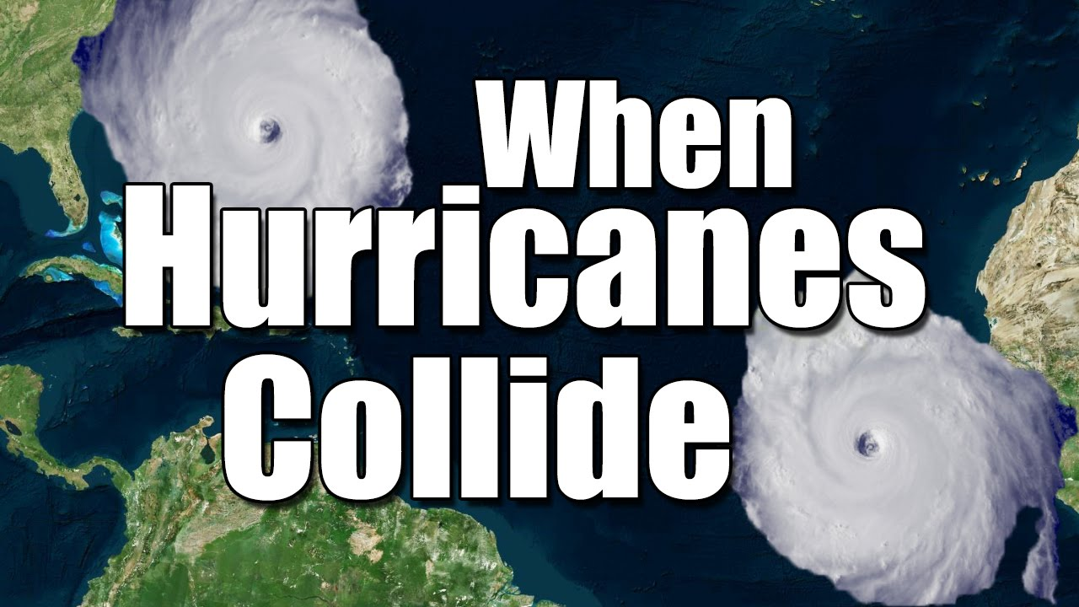
Fun facts about Hurricane Sandy (part b)
When there are two separate storms that later merge into one, there is a possibility to have “two eyes on the storm.
The act of having two storms is created by the Fujiwara Effect, which results from tropical cyclones rotating close nearby and later merging to be one hurricane.
The most dangerous part of a hurricane is the hurricane wall.
This is attributed to the powerful winds on the wall, which is presented to the right of the storm's forward motion, a region also referred to as the right-front quadrant.
Furthermore, the worst damage of the storm is discovered when the storm comes ashore and makes a landing.
Notes:
When there are two separate storms that later merge into one, there is a possibility to have “two eyes on the storm. The act of having two storms is created by the Fujiwara Effect, which results from tropical cyclones rotating close nearby and later merging to be one hurricane.
The most dangerous part of a hurricane is the hurricane wall. This is attributed to the powerful winds on the wall, which is presented to the right of the storm's forward motion, a region also referred to as the right-front quadrant. Furthermore, the worst damage of the storm is discovered when the storm comes ashore and makes a landing.

Slide 11
Conclusion
Hurricane Sandy is regarded historically as the second most dangerous hurricane after hurricane Katrina.
Hurricane Sandy reached a category 2 hurricane before it could die down in the region. Some of the detrimental impacts of the hurricanes were 650,000, which resulted in an economic loss of an estimated $70.2 billion.
Unfortunately, 147 persons lost their lives due to Hurricane Sandy. For days about 8.5 million people did not have power which resulted in difficulties in the rescue mission, especially in Haiti, which was the worst hit.
Nonetheless, there are fun factors on hurricanes in general that can be interesting. In a hurricane, the most dangerous part of a hurricane is the hurricane wall; a hurricane can have “two eyes on the storm and can generate tornadoes.
Notes:
Hurricane Sandy is regarded historically as the second most dangerous hurricane after hurricane Katrina. Hurricane Sandy reached a category 2 hurricane before it could die down in the region. Some of the detrimental impacts of the hurricanes were 650,000, which resulted in an economic loss of an estimated $70.2 billion. Unfortunately, 147 persons lost their lives due to Hurricane Sandy. For days about 8.5 million people did not have power which resulted in difficulties in the rescue mission, especially in Haiti, which was the worst hit. Nonetheless, there are fun factors on hurricanes in general that can be interesting. In a hurricane, the most dangerous part of a hurricane is the hurricane wall; a hurricane can have “two eyes on the storm and can generate tornadoes.

Slide 12
References
Lee, S., Benedict, B. C., Jarvis, C. M., Siebeneck, L., & Kuenanz, B. J. (2020). Support and barriers in long-term recovery after Hurricane Sandy: improvisation as a communicative process of resilience. Journal of Applied Communication Research, 48(4), 438-458.
Meng, S., & Mozumder, P. (2021). Hurricane sandy: damages, disruptions and pathways to recovery. Economics of Disasters and Climate Change, 1-25.
Mitsova, D., Esnard, A. M., Sapat, A., & Lai, B. S. (2018). Socioeconomic vulnerability and electric power restoration timelines in Florida: the case of Hurricane Irma. Natural Hazards, 94(2), 689-709.
Neppalli, V. K., Caragea, C., Squicciarini, A., Tapia, A., & Stehle, S. (2017). Sentiment analysis during Hurricane Sandy in emergency response. International journal of disaster risk reduction, 21, 213-222.

Slide 13
Brainstorming questions
When does hurricane season start?
What is the difference between a hurricane and a typhoon?
How did the government deal with Hurricane Sandy?
Where did Hurricane Sandy hit the hardest?
What tools are used to predict hurricanes?
How do we know a hurricane is coming?

